Slide 1
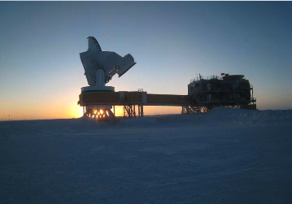
SPT Survey
Bolometer time stream: ~10⁶ T measurements/s integrated over 4 years with ~65% efficiency
Story et al 2012 astro-ph/1210.7231
Notes:
Equivalent to about 9hrs integration on each spot in the sky
Or about 32 million T measurements for each beam on the sky
>8 sigma detection of CMB lensing
First detection of 8th and 9th acoustic peaks

Slide 2
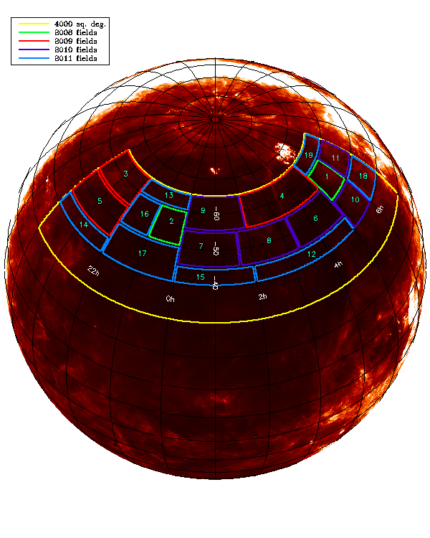
SPT Cluster Sample
Clusters selection:
  multi-λ matched filter method
  (Melin et al 2006)
750deg² sample
  224 candidates at S/N>4.5
  Followup “complete,”
  Song et al 2012, ApJ in press
2500deg² sample
  650 candidates at S/N>4.5
  Followup ongoing
SPTpol Sample
  ~600 deg², 4x lower noise
  Direct detection of groups, Main sample clusters pushed to ξ>20
Williams et al 2012, ApJ

Slide 3
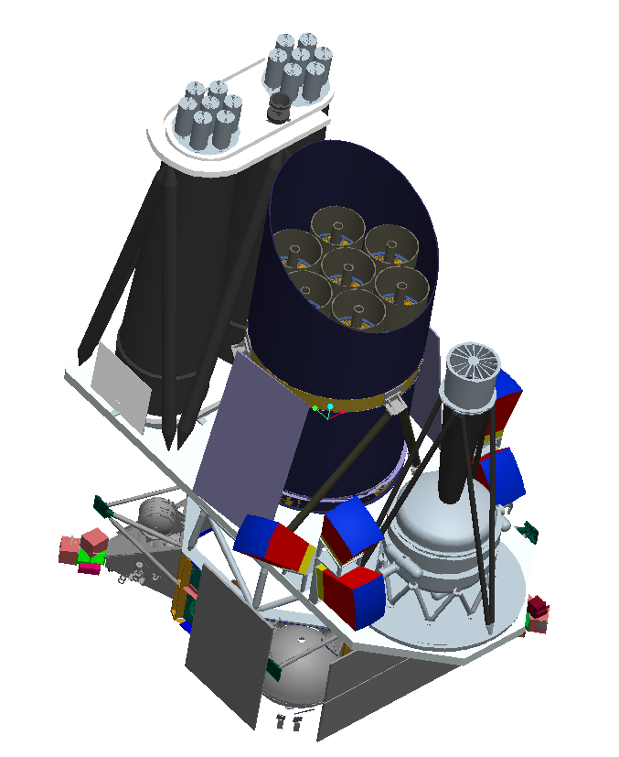
e-ROSITA

Slide 4
Optical Followup Comments
e-ROSITA
Multi-band optical imaging the key ingredient for removing contamination and measuring redshifts of the eROSITA sample
Redshift range suggests griz needed for the “new” systems
Spectroscopy needed for a representative subsample to calibrate the photo-z’s
Pillepich et al 2012

Slide 5
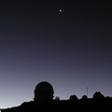
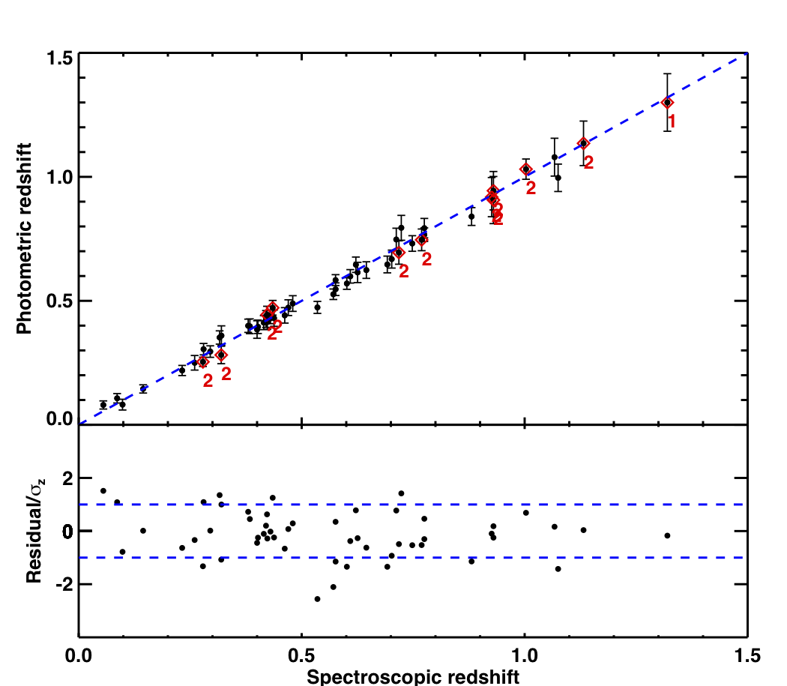
SPT Optical Followup
We use multiband photometry to get red sequence cluster redshifts
Began with dedicated survey
  Blanco Cosmology Survey –
  60 nights/ 80 deg²/griz
  see Desai et al 2012 (astro-ph/1204.1210)
Now we go cluster by cluster
  ~100 nights on the telescope so far
  Over 500 candidates imaged to date
  Goal: finish within a year
Song et al 2012
Characteristic scatter δz/(1+z)~0.018 for 0<z<1.4
For 53 clusters with spec-z’s
Notes:
Optical counterparts first found on July 14, 2008!

Slide 6
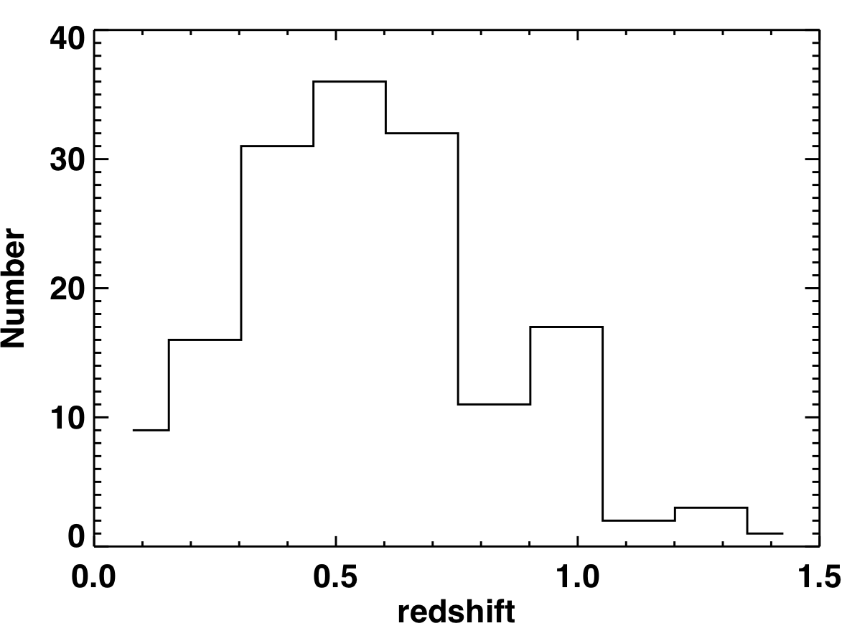
SPT Clusters: Redshift Distribution
Characteristics of 750 deg² sample:
  224 candidates (>4.5σ)
  158 with measured photo-z’s
    9 more with significant NIR galaxy overdensities
  Median redshift is ~0.54
  18% of sample with at z>0.8
Song et al 2012, ApJ
Notes:
Note the results of XDCP…

Slide 7
Initial eROSITA Cluster Selection
e-ROSITA
The eROSITA survey PSF is similar to the ROSAT PSPC inner ring PSF for pointed observations
  Thus, our task is similar to that of Vikhlinin/Burenin et al in the 400d survey
Experience shows that X-ray only selection with this image quality can produce ~90% pure sample
Optical confirmation allows the purity to be pushed to ~100%, at least for M>10¹⁴M_{o}
eROSITA requirements are much stricter than Vikhlinin’s (we have 1000X larger sample), but we have multiband optical data over the bulk of the extragalactic sky.
  We optically confirm EVERY source, regardless of extent

Slide 8
Confirmation of Galaxy Population
Over the broad redshift range of the SPT sample, we use optical and NIR imaging to probe for the galaxy population
Quantitative 3D overdensity provides confirmation likelihood for all systems
SPT-CL J0417-4748 at z = 0.62
^{SPT-CL J2106-5844 at z} ^{= 1.133}
SPT-CL J0638-5358 at z=0.222
Notes:
Optical counterparts first found on July 14, 2008!

Slide 9
SPT Clusters: Contamination
Negative noise peaks can masquerade as clusters
  - Stay at high S/N!
Optical confirmation allows us to measure the contamination
Song et al 2012, ApJ
SPT-only selection produces >95% pure sample at S/N>5
SPT+optical followup produces ~100% pure sample at S/N>4.5

Slide 11
Mass Calibration Comments
e-ROSITA
eROSITA selection is described by the properties of the Lx-mass relation over the full range of the survey
We have to find a way to parametrize this relation
  Power law/broken power law? Redshift evolution? Character of scatter?
Then we have to use empirical mass measurements to constrain these parameters
Because mass measurements themselves and survey selection effects are cosmology dependent, the mass calibration must be done together with the cosmological study

Slide 12
The SPT Experience: Mass-Observable Relation
SPT clusters are selected by S/N or ξ- therefore to do cosmology we must understand the ξ-mass relation
  Power law: 3 params plus log-normal intrinsic scatter
Calibration Strategy:
  Phase I: Rely on simulations
  Phase II: Transfer Y_{x}-mass calibration to SPT using Chandra observations of small ξ-selected subsample
  Phase III: Use Weak lensing, X-ray and velocity dispersions of SPT selected clusters

Slide 13
Phase I Mass Calibration
Vanderlinde et al 2010
  Characterize masses using sims (Bode et al- zero gas physics) calibrated using local cluster X-ray scaling relations – adopt weak priors on ξ-mass
  Cosmological consistency test:
    Use WMAP chains and include likelihood of cluster counts for each model
    Use 21 clusters at ξ>5 in original 178 deg² survey fields
σ₈=0.804 (0.092)
w=-1.049 (0.291)
σ₈=0.788 (0.035)
w=-0.966 (0.049)

Slide 14
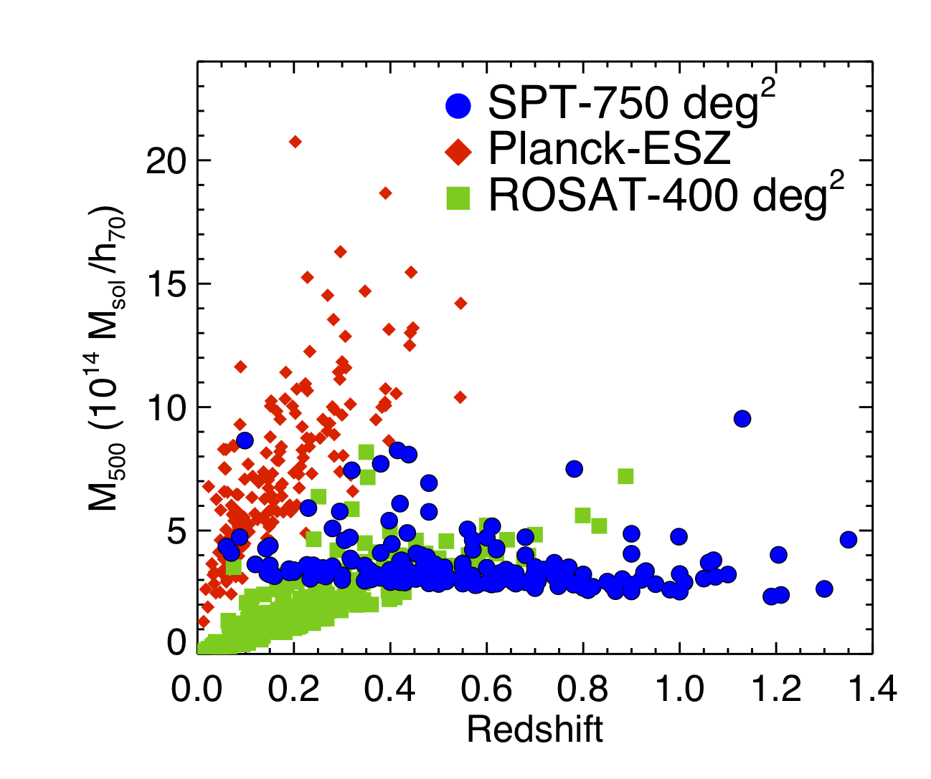
Phase II Mass Calibration
Andersson et al 2011
Y_{x}-mass relation from Vikhlinin
  Calibrated locally using hydrostatic masses, extrapolated to high redshift
Provides insights into SPT selection
  M₂₀₀>4x10¹⁴ M_{o} at z>0.1
Combination of mass selection and large solid angle means we turn up rare, massive clusters at high z
Andersson et al 2011
Notes:
0528-5300 4.3x10^14
0600-5249 8.9x10^14
0509-5342 8.1x10^14

Slide 15
Phase II Cosmology
Reichardt et al 2012 astro-ph/1203.5775
100 clusters from 750 deg²
  S/N>5, z>0.3
  Mass calibration from X-ray hydrostatic masses as z~0.3
Cosmology limited by mass uncertainties
Cosmological constraints:
  WMAP+SNe+BAO+H0:
    σ₈ = 0.84 (0.04)
    w=-1.054 (0.073)
  Above + SPT Clusters
    σ₈ = 0.81 (0.03)
    w=-1.010 (0.058)
Consistent with X-ray cluster analyses- see Vikhlinin et al 2009, Mantz et al 2010

Slide 16
Phase III Mass Calibration
Weak Lensing:
  18 z~0.3-0.4 clusters with Magellan Megacam
  7 z~0.6-0.8 clusters with HST+VLT
  7 z>0.8 clusters with HST+VLT
X-ray:
  XVP with Chandra to get Y_{x}’s of ~80 high ξ clusters
  XMM obs of ~30 clusters (Magellan WL and high-z)
Velocity dispersions:
  ~100 cluster velocity dispersions from ~25 member velocities using Gemini GMOS-S at z<0.8, VLT FORS2 at z>0.8 and MagellanIMACS as available

Slide 17
Weak Lensing Mass Calibration
High+Hoekstra, Schrabback+Dietrich
Goal:
  Direct calibration of ξ-mass over full redshift range
  Rely on simulations to characterize biases
Initial analysis of 5 systems
  High et al 2012, ApJ
  Shear catalogs -> Henk Hoekstra
  gri imaging, color-cuts
Current Status
  Magellan analysis advanced
    High/Hoekstra
  HST+VLT analysis ongoing
    Pursuing EUCLID-like strategy
    HST for the shear catalogs (Schrabback)
    VLT photometry for color cuts/photo-z’s (Dietrich)
SPT2022-6323
High et al 2012, ApJ

Slide 18
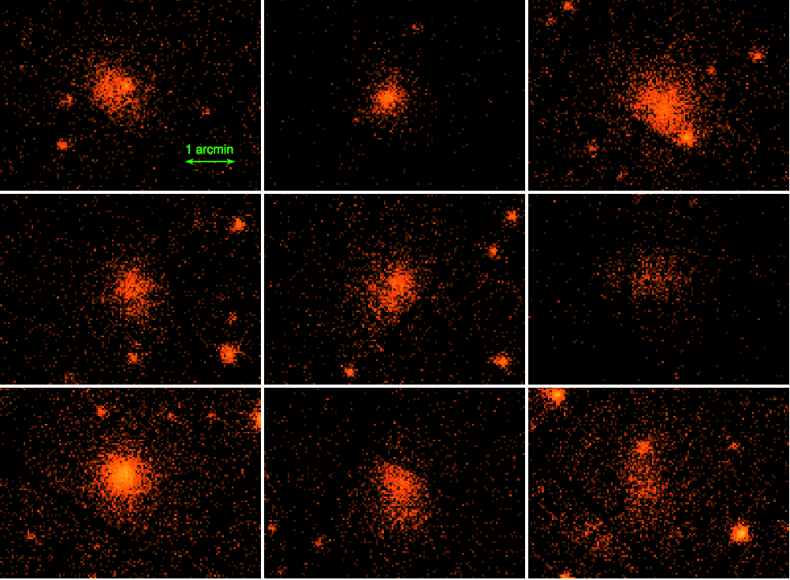
X-ray Mass Calibration
McDonald and Suhada
Goal:
  Y_{x} is low scatter mass proxy and therefore is useful for constraining scatter in ξ-mass relation
  Y_{x} –mass must be calibrated at z>0.3
Current Status
  Chandra data still arriving
    Mike McDonald
  XMM data all in place
    Robert Suhada
Robert Suhada
XMM High-z Sample

Slide 19
Velocity Dispersion Mass Calibration
Bazin, Ruel, Saro and Bocquet
Goal:
  Dispersions are high scatter mass proxies
  Rely on simulations for calibration- to characterize biases
  esp. interesting at high z
Current Status
  Data acquisition continuing at Gemini, VLT and Magellan
  Initial “data paper” imminent
    Ruel, Bazin et
  Y_{x}+σ calibration underway
Bazin et al, in prep

Slide 20
Calibrating ξ-mass with σ and Y_{x}
Scaling relations:
  Amplitude, Slope, Redshift evolution and Intrinsic scatter for each relation
  Cosmology dependent
Method:
  Given scaling relation params:
  Use (ξ,z) to predict P(σ), P(Y_{x})
    including selection effects like Eddington bias
  Extract likelihood of consistency with observed σ and Y_{x}
  Iterate
M200
Bazin et al, in prep

Slide 21
Amplitude-Scatter Degeneracy
Eddington Bias leads to amplitude-scatter degeneracy
  A given ξ maps into mass according to amplitude A
  Scale of Eddington bias depends on scatter D
  Different combinations of A/D lead to same predicted mass distribution and P(σ)
    A,D=(6,0.2)-blue and (4.3,0.3)-red
A/D Degeneracy from direct calibration not exactly aligned with A/D degeneracy from counts
What do we know about scatter D?
  Y_{x}+Counts constraint: 0.21+/-0.09
  Benson et al astro-ph/1112.5435
Bazin et al, in prep

